Slide 1
Agenda (5 July 2019)
9:30 – Welcome by Vice Dean: Prof. Chin Wei Ngan
9:50 – Big Photo together
10:00 – Briefing by Program Director: Prof. Tan Tiow Seng
11:00 – Lunch (here)
12:00 – Walkthrough UTown → Sport Complex / UHC → YIH →
Chinese Library → Central Library →
AS6: LT15 → COM1: SR9 →
COM2: LT16, LT19, TR9
14:00 – First lecture @ LT15 (Multimedia/VR/AR)
@ LT16 (Dig data/Cloud)
@ LT19 (AI/Security)
@ SR9 (Computational Biology)
17:00 – Dinner (??)
18:30 – Second lecture @ LT15, LT16, LT19

Slide 2

陈朝成 Tan Tiow Seng
Program Director
Slides are not to be reproduced – all photos were taken from web without asking for permission.
https://www.youtube.com/watch?v=iSEzDoKNFtA (Singapore Pie 2.0)
https://www.youtube.com/watch?v=DAy5WgkhLdM (麻雀衔竹枝)

Slide 3

从
花园城市
到
城市花园

Slide 4
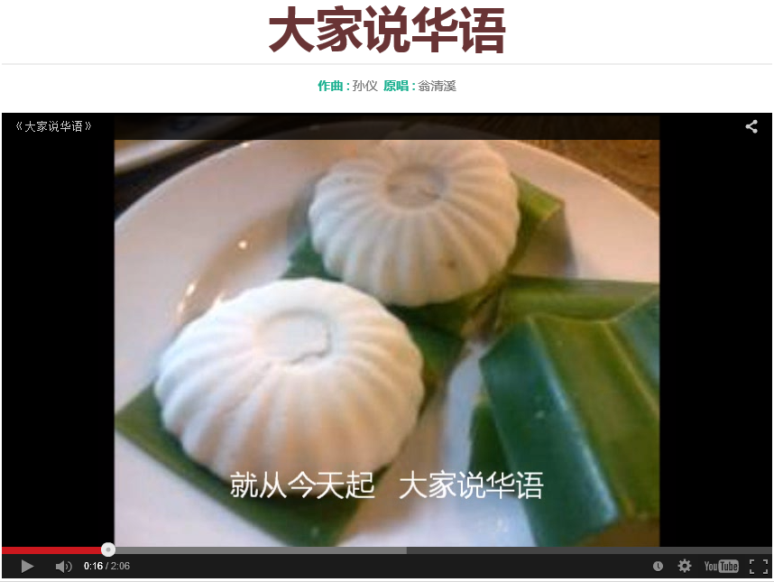
Mandarin Speaking
Notes:
Our development is tong-pu with China reform 1979…way before you were born.
Strange, all the cake – we don’t have a chinese names to them….

Slide 5
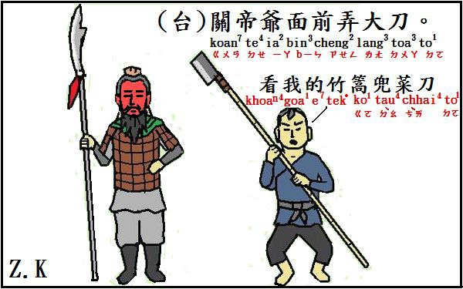
Notes:
Good – then you laugh, no good, just laugh

Slide 6

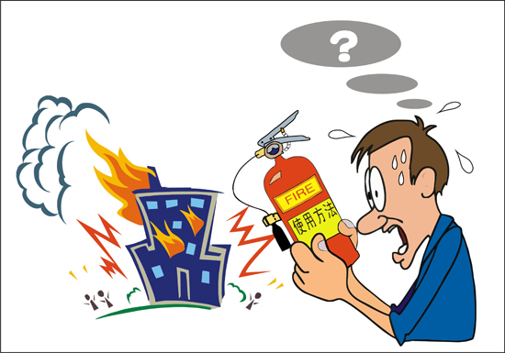
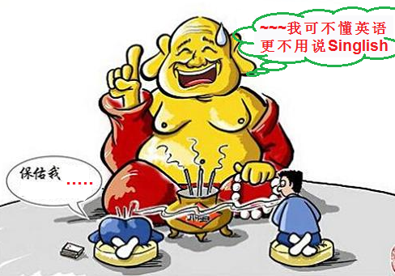

Slide 7
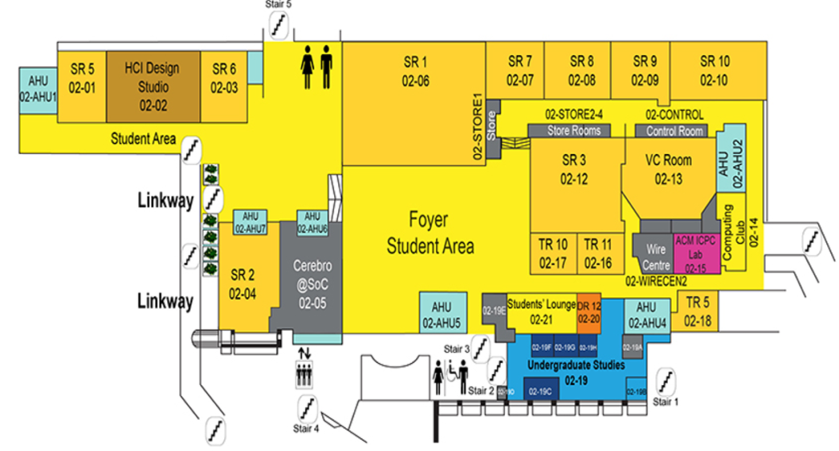
新加坡的朋友 (Singapore’s Friends)
陈老大 (Chen 수석)
NUS/SOC Staff
Liv Dai
Evan Tan (8200 5539)
Tan Zi Qing (8155 8226)
学生助理 90后
Lee Wei Gen (8308 9230)
Jil Ong (9776 0182)
Foo Yong Cheng (9753 2842)
Erica Jane Tem (8484 4371)
Crystal Lee (9641 1996)
Ang Jamais (9726 3231)
Andy Lam (9128 3208)
Jordan Seow (8218 1128)
Joshua Seet (9827 9212)
Lawnce Goh (9691 6575)
Lim Jun Hup (9236 2576)
Toh Jia Xuan (9220 3857)
Xue Hui (9336 0707)
IT服务 (IT Services)
COM1-02-16: TR11
Huang Jun Xiang
Yan Zhang Lu
Han En Dong
One-Stop Office
一站式服务
COM2-01-08: TR9
Notes:
No Singaporean here – 不 不扣 for three of them

Slide 8
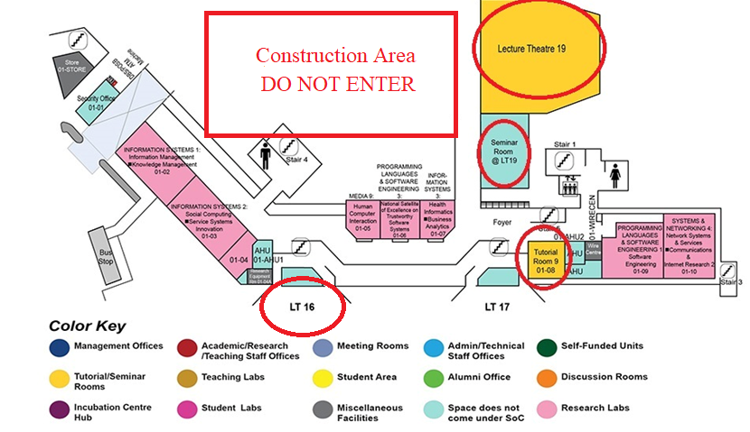
COM2: TR9

Slide 9
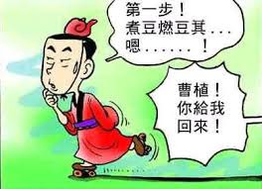
Don’t Kill Each Other
七步诗 / 相依为命
煮豆燃豆萁，
豆在釜中泣。
本自同根生，
相煎何太急。
Notes:
8 to 400 = 50
/ 相依为命

Slide 10
Emergency Contacts
* Call student helpers for minor issue
* Call NUS Staff for more than minor issue
Ambulance & Fire: 995
Non-Emergency Ambulance: 1777
Police: 999

Slide 11


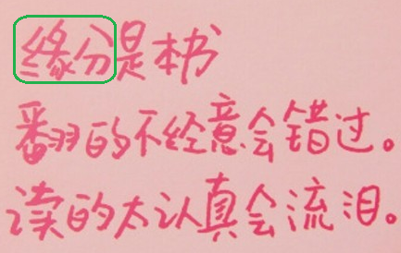
要用心…Attention
1. Health
2. Study
3.Fate

Slide 12
要用心…Attention
1.
Health

Slide 13

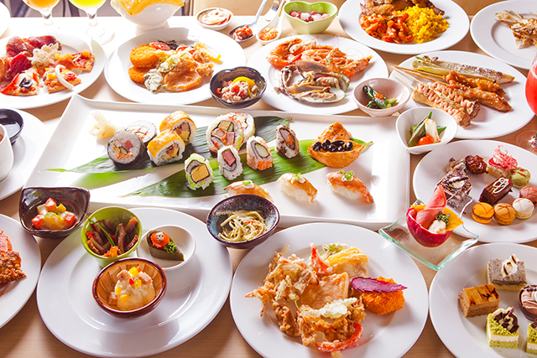
1. Health 健康
美食天堂

Slide 14
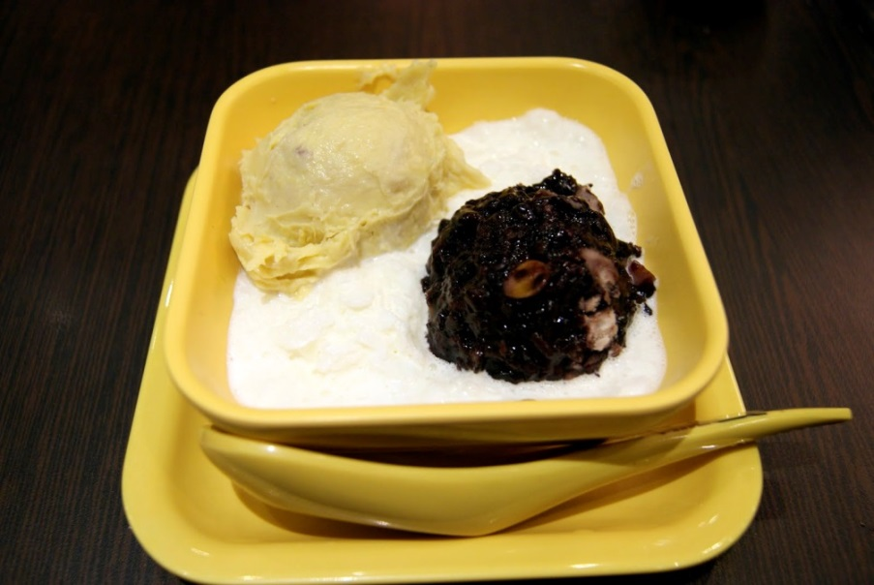
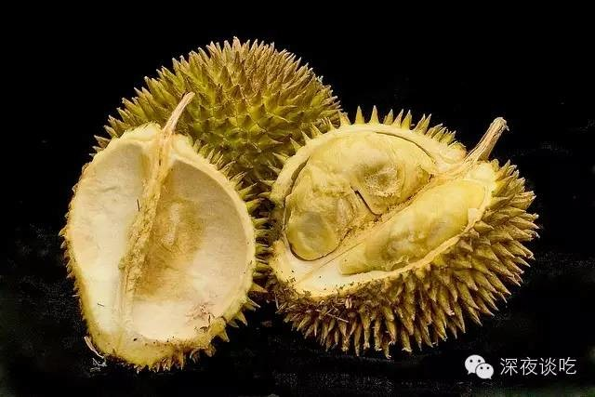
1. Health 健康
Do not eat heaty stuff e.g.榴莲忘返
Bring a jacket with you to class

Slide 15




1. Health 健康
Smoke-free Campus

Slide 16
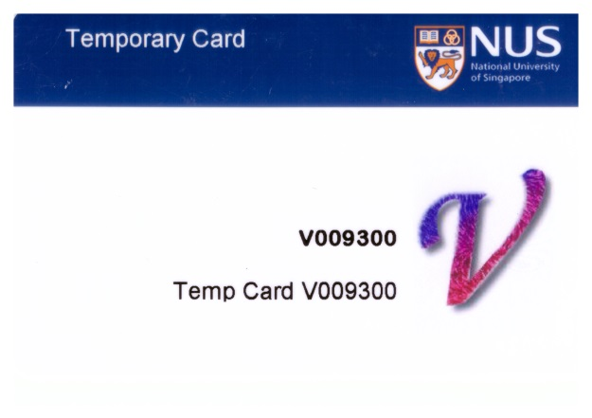
1. Health - Sport
If have signed up, Email has been sent to t0xxxxxx@u.nus.edg
Login to: https://reboks.nus.edu.sg (resource booking system)
Top-up $20 for eWallet
Swimming pool, per entry at $0.5 or $0.65.
Need your temp card or photo ID – need to check yourself.
Can share a QR code
Gym, per entry at $1.25
Need your temp card or photo ID.
can’t share a QR code
Running around is free
Temp card allows access to doors/gates
Take a photo of your temp card

Slide 17
1. Health - Wifi
In NUS campus:
Use t091xxxx, with network NUS_STU_2-4GHz
Note the “NUS Acceptable Use Policy for IT Resources”
Remember to change password before using
Remember to remember your new password
Off-campus (26 July onward):
Details will be provided in due course

Slide 18
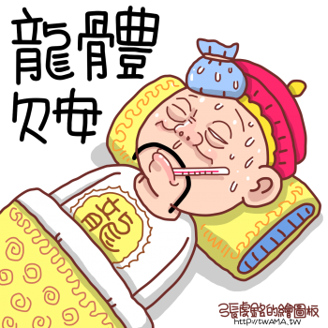
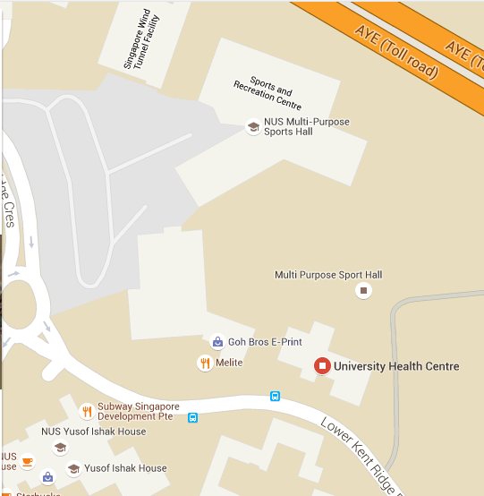
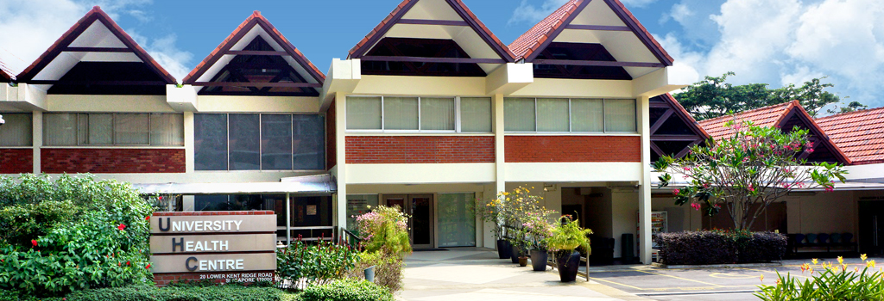
1. Health 健康
不让身体不开心 (we take care of UHC medical fee)
Inform us or through your friend always, if not feeling good
Student helper standby UHC in the morning – can go direct with passport
University Health Centre (UHC)
20 Lower Kent Ridge Road, 119080

Slide 19
要用心…Attention
2.
Study

Slide 20
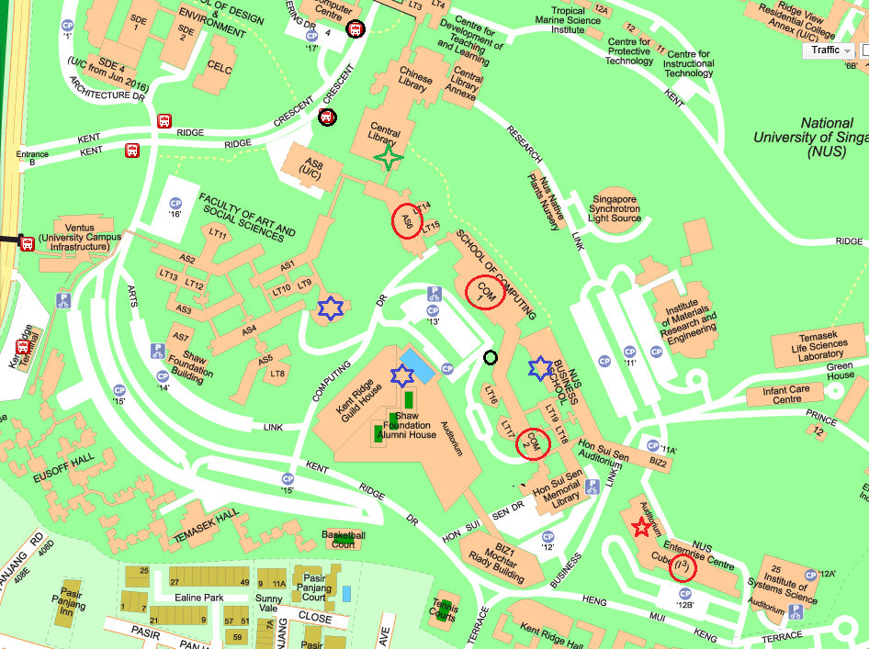
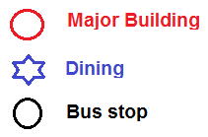
2. Study 充实
Buildings: Library – AS6 – COM1 – COM2 – BIZ – I3
(Yellow Roof)
Many quiet places for
review & discussion
(COM1, basement)
Your classroom is yours
mostly

Slide 21
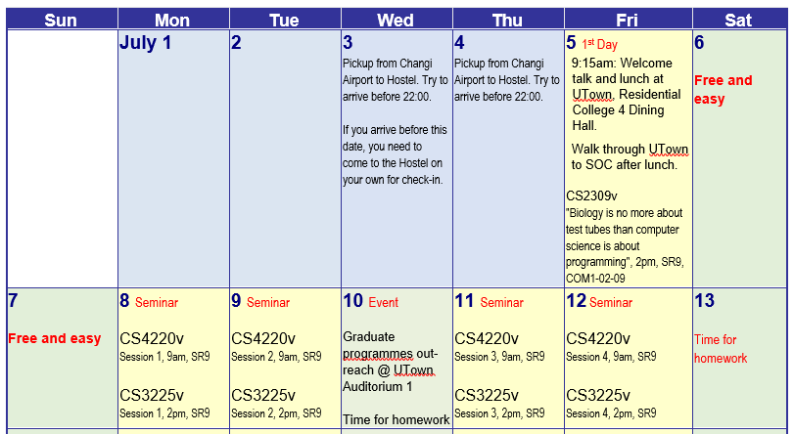
2. Study: Schedule – Comp Biology

Slide 22
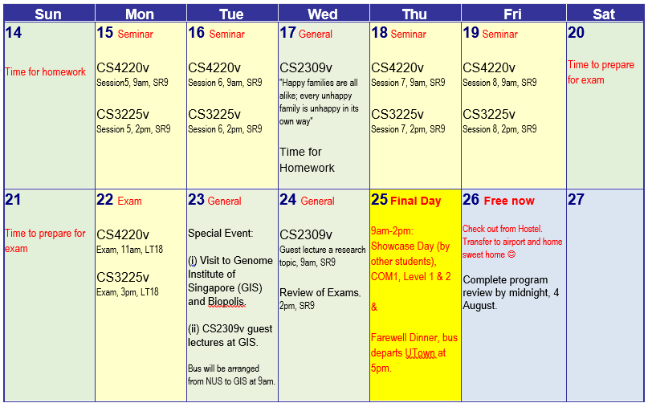
2. Study: Schedule – Comp Biology
c

Slide 23
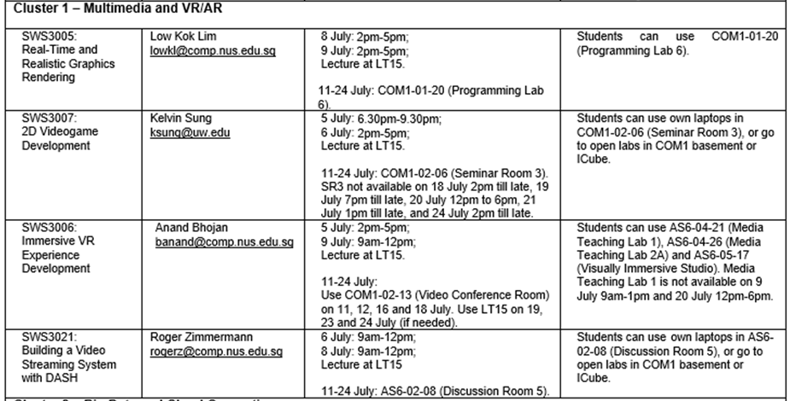
2. Study 充实 : Cluster 1
Can also attend SWS3018, 8 July, 9 July: 6:30pm – 9:30pm
Classroom may change upon confirmation on 10 July

Slide 24
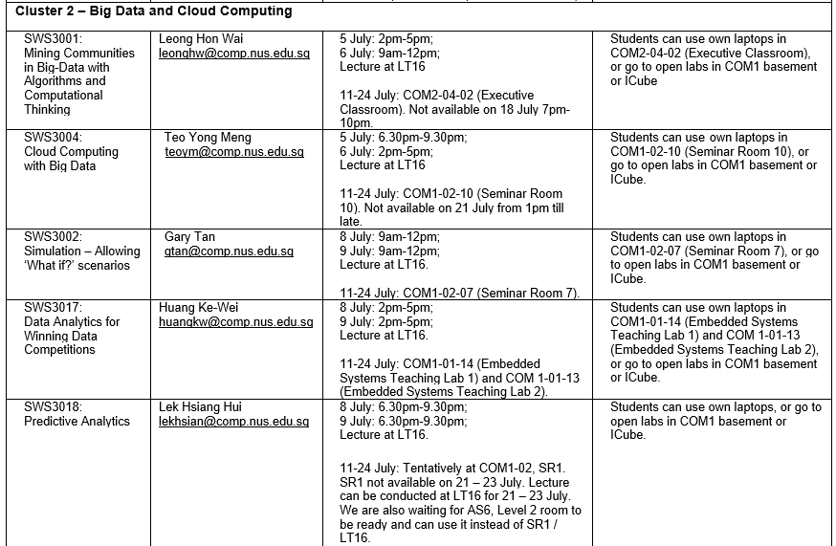
2. Study 充实 : Cluster 2
SWS3018, 8 July, 9 July: 6:30pm – 9:30pm – open to all clusters –
BUT will not accept new students
SWS3001 will not accept new students

Slide 25
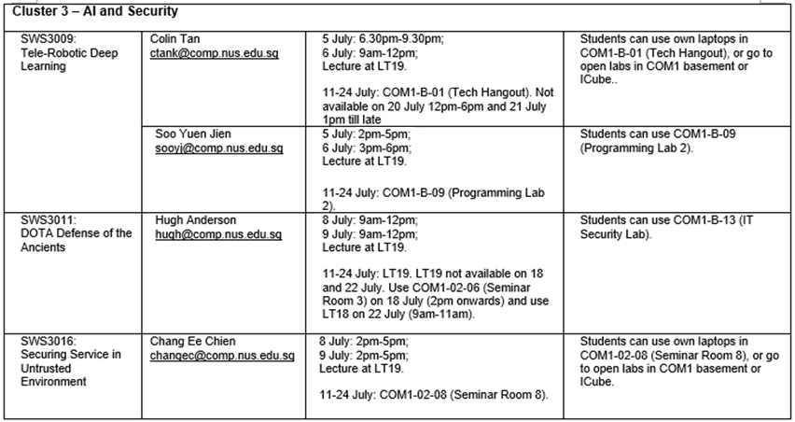
2. Study 充实 : Cluster 3
Can also attend SWS3018, 8 July, 9 July: 6:30pm – 9:30pm
Classroom may change upon confirmation on 10 July
Colin Tan & Soo Yuen Jien are to have the same number of students (max 88)

Slide 26
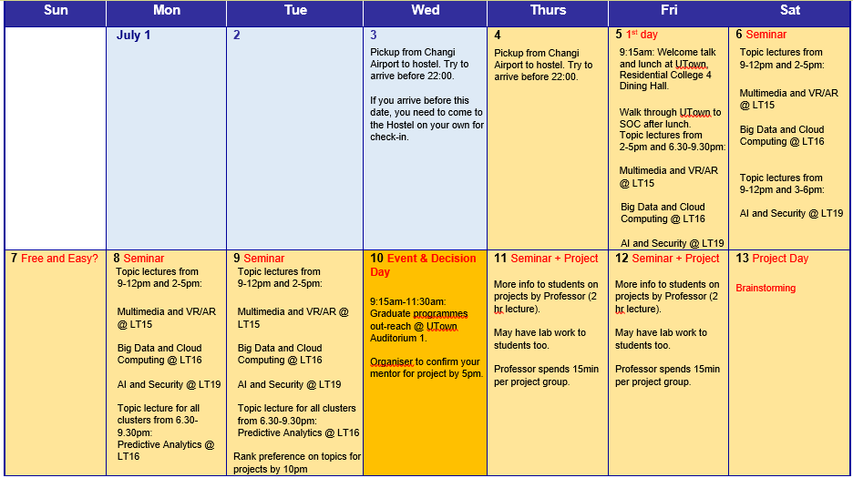
2. Study: Schedule

Slide 27
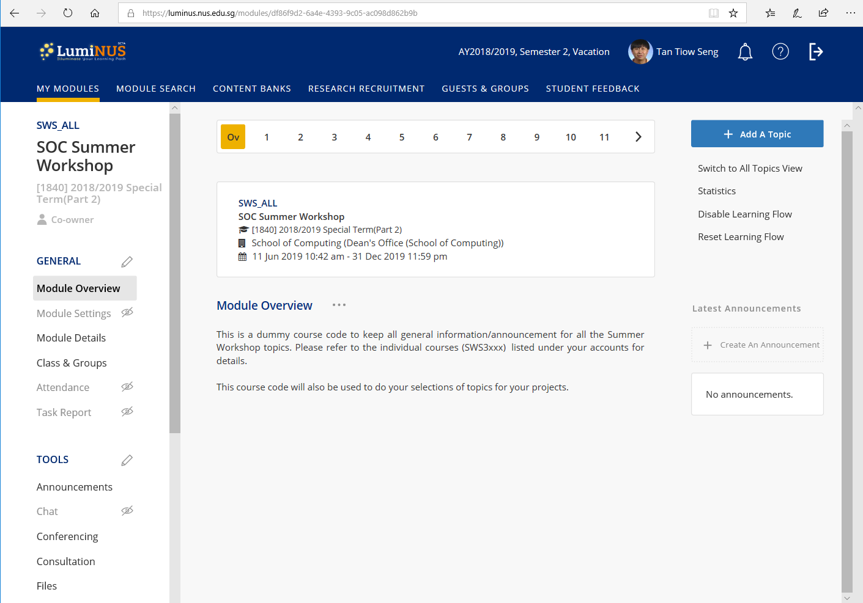
2. Study: Luminus
All of you are in SWS_ALL, and you belong to just one cluster….
( https://luminus.nus.edu.sg/ )

Slide 28
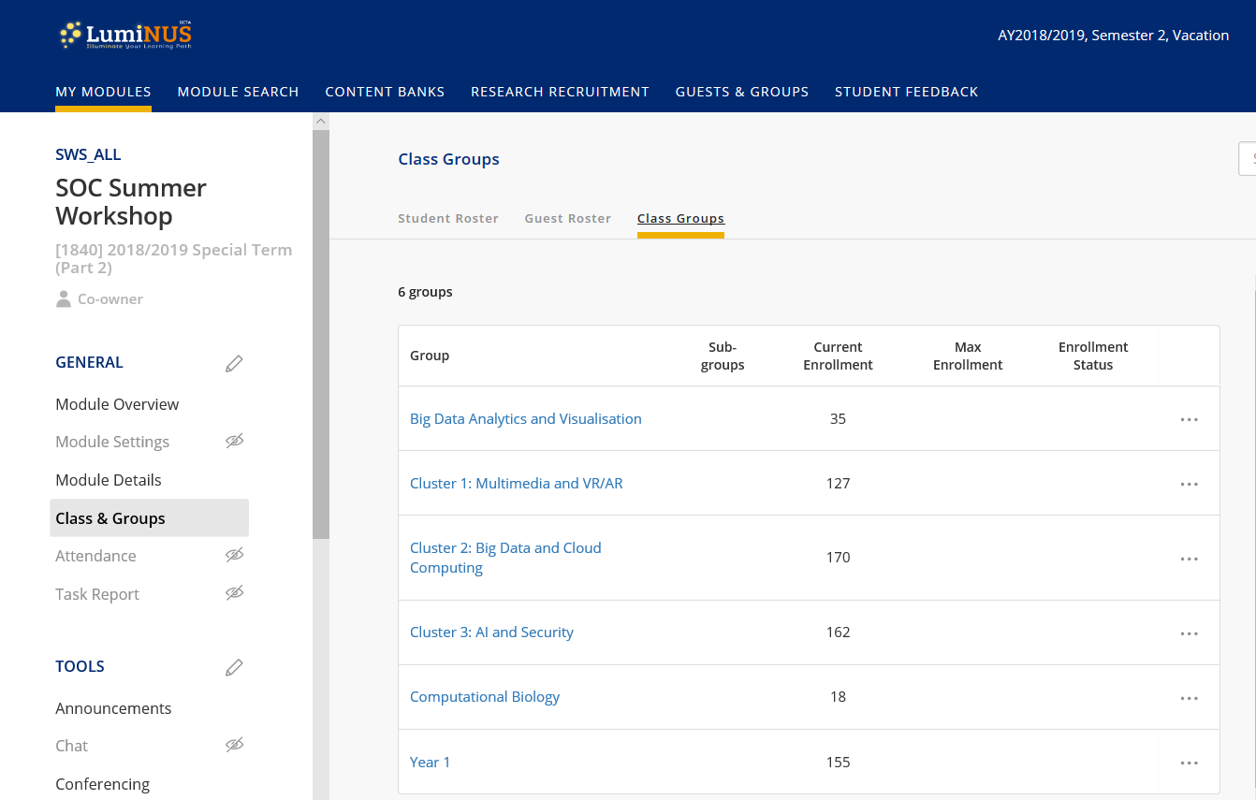
2. Study: Luminus
You are in one of the 3 clusters, or Computational Biology.
For those in the 3 clusters: there should be 4 or 5 courses listed in your account, and you will see only SWS_ALL and your assigned topic after 10 July.

Slide 29
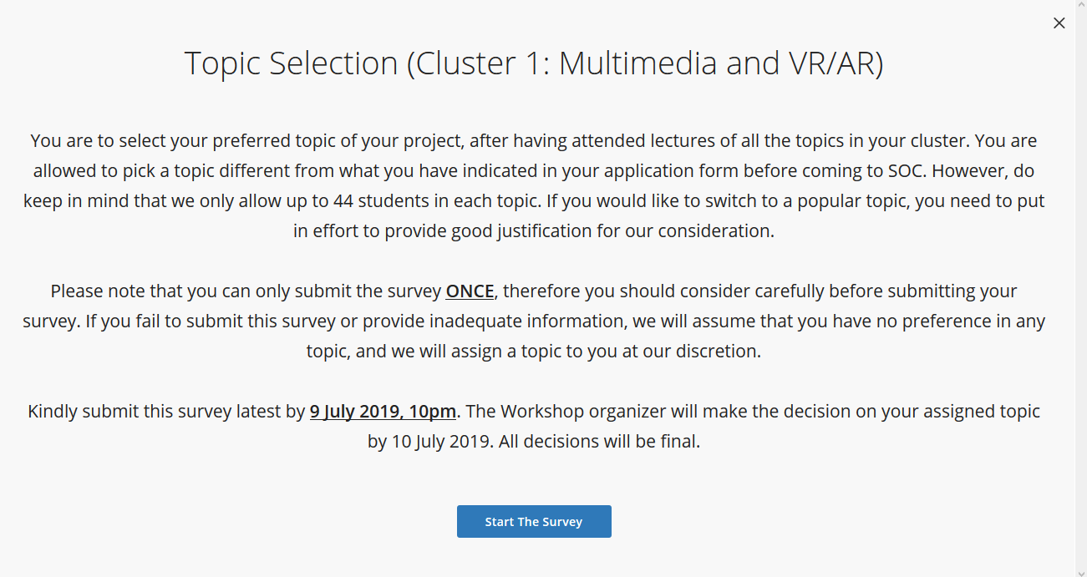
2. Study: Topic Selection
Click on the survey button to see it.
Open: 8 July 2019, 21:01
Close: 9 July 2019, 22:00

Slide 30
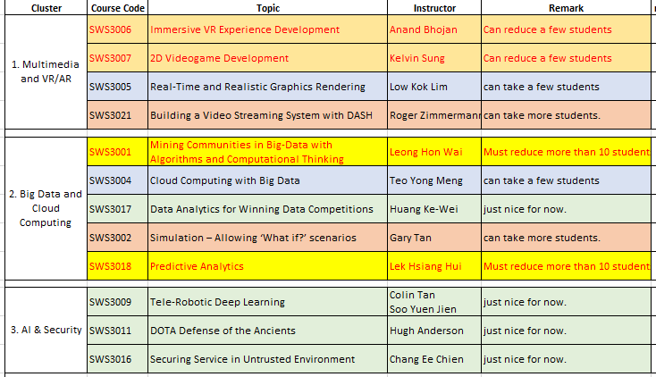
2. Study: Topic Selection
2 half-day seminars per topic in your cluster
Walk to SOC or shuttle Bus; breakfast; class starts at 9am.
Performance in quiz/assessment, besides academic background, helped to decide which is your suitable topic.
Orange
Green
Blue

Slide 31
2. Study: Project Work
You will see only SWS_ALL + SWS30xx in Luminus. Possible to integrate topics into projects.
Your records will be replaced on 10 July once topic is confirmed. Please do your backup if you want the files.
Different modes by different professors / budget for “good” performance
Assignments (individual or group) be given as well as group projects
Each classroom is assigned to only one topic.
So, classroom is yours except timeslots not available as indicated

Slide 32
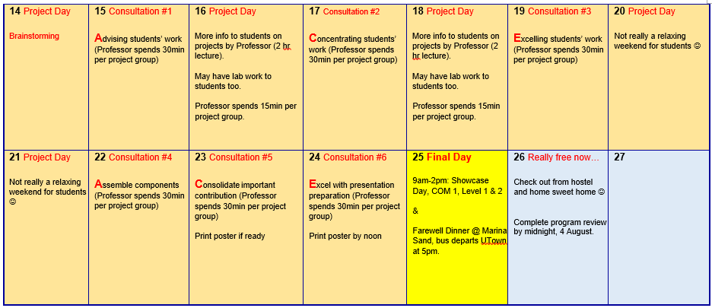
2. Study: Poster Printing
Each project group is given 1 page of A1 Poster for free
Printing is at COM1, Level 1, Technical Service Counter
Need to show temp-card, sign on paper to print
DO NOT wait till 24 July to print your posters !
Printing 1 poster takes about 15 minutes – don’t want to wait and pray
There are 120 posters to be printed – it takes more than 30 hours to print all !!!

Slide 33
2. Study: Showcase (25 July)
Showcase on 25 July, 9:00am – 2:00pm, COM1 Level 1 and Level 2.
Some groups may need to set-up equipment on 24 July
You are to “evaluate” projects of other topics
Each group has a poster stand, a desk for a demo PC, but no chairs in general
Event Coordinator: Dr Anand Bhojan
More info will be provided; prizes presentation at around 13:30

Slide 34
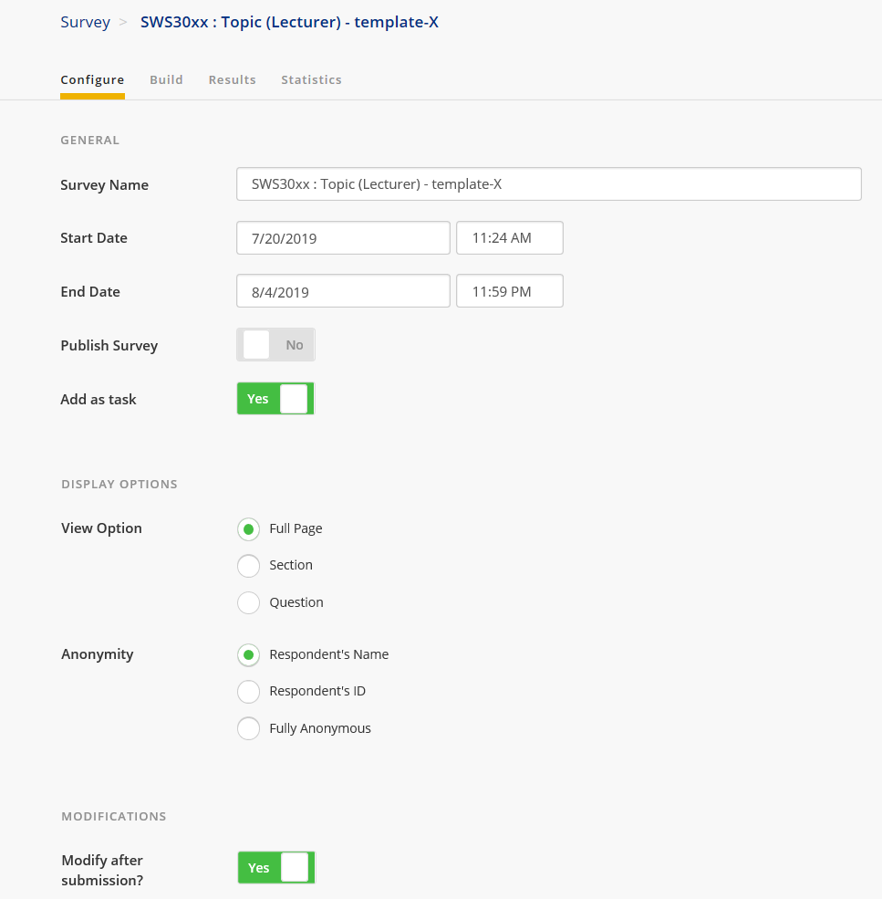
2. Study: Feedback (by 2 Aug)

Slide 35


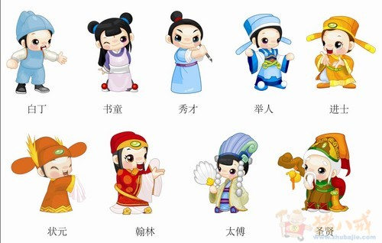

2. Study 充实

Slide 36
2. Study 充实
https://www.youtube.com/watch?v=RTy8a0_7T-o 小人物的心声

Slide 37

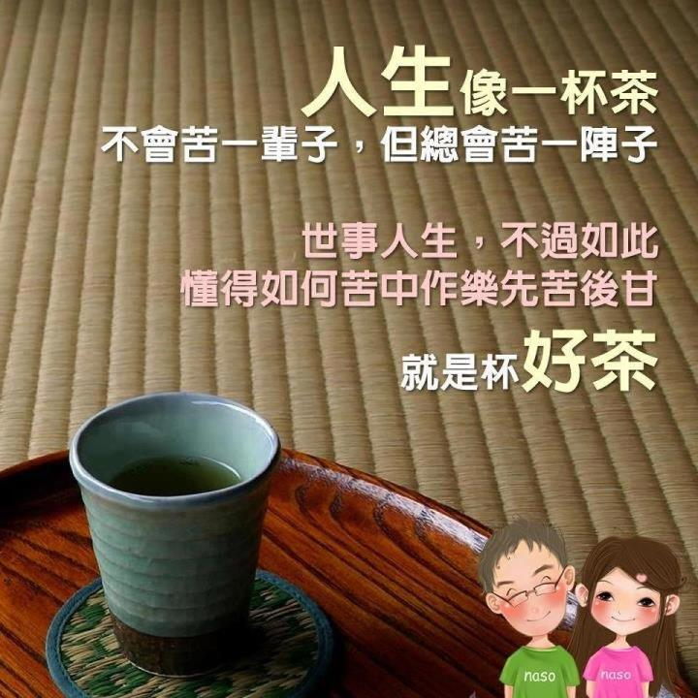
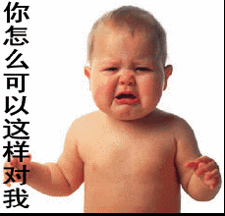
2. Study 充实

Slide 38
要用心…Attention
3.
Fate

Slide 39


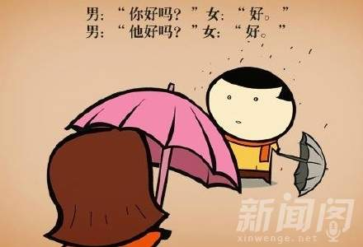

3. Fate 缘分

Slide 40
3. Fate 缘分
https://www.youtube.com/watch?v=6mYw53V9RGM&list=RDp4srZf2o_j0&index=22 情非得已

Slide 41

3. Fate 缘分
Living under the same roof
Clean, Considerate, Calm, ….
Doing projects together
Active learner
Respect, Responsible, …
Exploring SG together
Safety first
Tap transport card on and off bus
You and US too: write to us if you care….

Slide 42

3. Fate 缘分
9 July, 10pm: Deadline to decide on topic at Luminus
10 July : UTown Briefing (Town Hall Auditorium 1)
What are our graduate programs and their applications
10 July, 17:00 : Announce decision on topics
14 July, 23:59: Input transport needs to Airport at Luminus
Check out by 6pm, 26 July 2019
23 – 24 July : Print Poster
Free 1 page. Need to show your temp card, and sign.
Additional page at $12/page.

Slide 43

3. Fate 缘分
25 July : Showcase 9:00am - 2:00pm
May need to setup on 24 July for those with equipment
25 July : Farewell Dinner @ Marina Sand
Pick up from UTown at 5:00pm
Need your temp card to gain entrance (or pay $10 for entrance)
Have limited slots for your performance (send us info)
26 July : Check out and airport transfer
Check out by 6:00pm if not going to airport
2 August : Feedback to be done in Luminus
Video Competition….

Slide 44



3. Fate 缘分
Submission Time Line:
14 July – 2 August: indication of intent
3 – 10 August: 1st Draft
10 – 18 August: Final submission
Early September: Announcement of winners
1st Prize: TBC 2nd Prize: TBC 3rd Prize: TBC
* Photos sharing will be made available

Slide 45



3. Fate - Internships
Applications:
5 internship positions available
Length: 4 months @ $1500/month allowance
Must received A or A+ in topic to qualify
Must have recommendation from professor
of the topic
Should secure a professor to supervise
Application is processed end of each month,
and open till March 2020, or when all positions are used up.

Slide 46
Agenda (5 July 2019)
9:40 – Welcome by Vice Dean: Prof. Chin Wei Ngan
9:55 – Big Photo together
10:10 – Briefing by Program Director: Prof. Tan Tiow Seng
11:00 – Lunch (here)
12:00 – Walkthrough UTown → Sport Complex / UHC → YIH →
Chinese Library → Central Library →
AS6: LT15 → COM1: SR9 →
COM2: LT16, LT19, TR9
14:00 – First lecture @ LT15 (Multimedia/VR/AR)
@ LT16 (Dig data/Cloud)
@ LT19 (AI/Security)
@ SR9 (Computational Biology)
17:00 – Dinner (??)
18:30 – Second lecture @ LT15, LT16, LT19

Slide 47

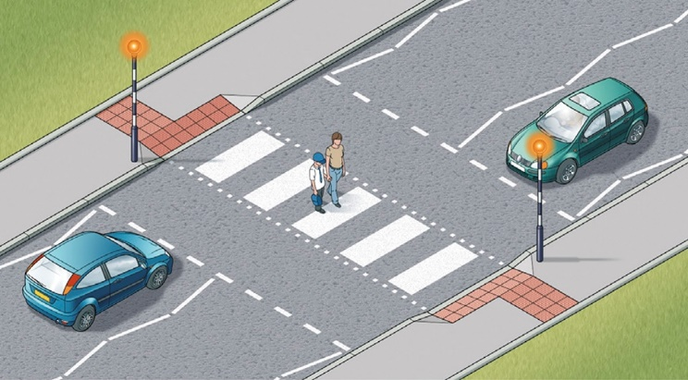
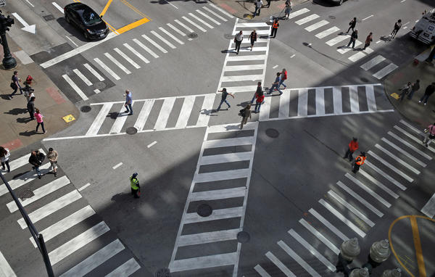
Coming up….12:30pm
Assemble outside dinner hall, group of 70 or so, walk from
Walk from UTown (cover walkway / bridge)→
from Carpark #5 into Sport Complex / UHC
follow yellow roof to YIH →
up up to Chinese Library →
down to Level 4 Central Library →
down to Level 1 AS6: LT15 →
down to Level 2 COM1: SR9 →
down to Level 1 COM2: LT16, LT19, TR9

Slide 48
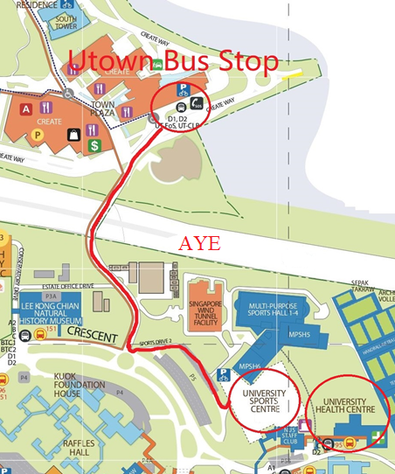
Walk safely….
Walk from UTown Bus-stop crossing
the covered walkway to main campus
Follow the red route to pass by University Sports Center (USC), or go into USC (through carpark #5) (note: University Health Centre is nearby)
Up a stairway to connect from USC to YIH
enter into Yusof Ishak House (YIH)
Follow Yellow roof towards
Student Unions
Chinese Library
Central Library
AS6 ground floor / LT15
COM1 Level 2 / SR9
COM2 ground floor / LT16, LT19, TR9

Slide 49
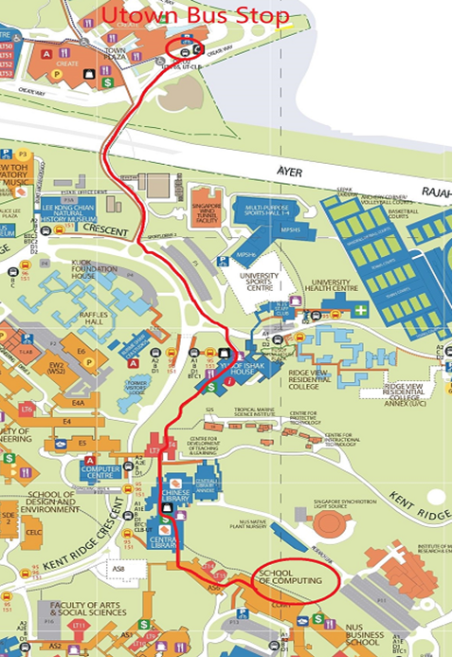
Walk safely….
Walk from UTown Bus-stop crossing
the covered walkway to main campus
Follow the red route to pass by University Sports Center (USC), or go into USC (through carpark #5) (note: University Health Centre is nearby)
Up a stairway to connect from USC to YIH
enter into Yusof Ishak House (YIH)
Follow Yellow roof towards
Student Unions
Chinese Library
Central Library
AS6 ground floor / LT15
COM1 Level 2 / SR9
COM2 ground floor / LT16, LT19, TR9

Slide 50
Lectures @ 9 – 12noon, 2 – 5pm; 6:30 – 9:30pm
Cluster 1: Multimedia and VR/AR @ LT15
Real-time and Realistic Graphics Rendering
2D Videogame Development
Immersive VR Experience Development
Building a Video Streaming System with DASH
Cluster 2: Big Data and Cloud Computing @ LT16
Mining Communities in Big-Data with Algorithms and Computational Thinking
Cloud Computing with Big Data
Simulation – Allowing “What-if?” Scenarios
Data Analytics for Winning Data Competitions
Cluster 3: AI and Security @ LT19
Tele-robotic
Deep Learning
DOTA Defense of the Ancients
Securing Service in Untrusted Environment
Computational Biology @ SR9 (White)
For all clusters on 8 July & 9 July
Lecture on: Predictive Analytics @ LT16, 6:30pm – 9pm
(ALREADY CROWDED – need to reduce > 10 students)

Slide 51
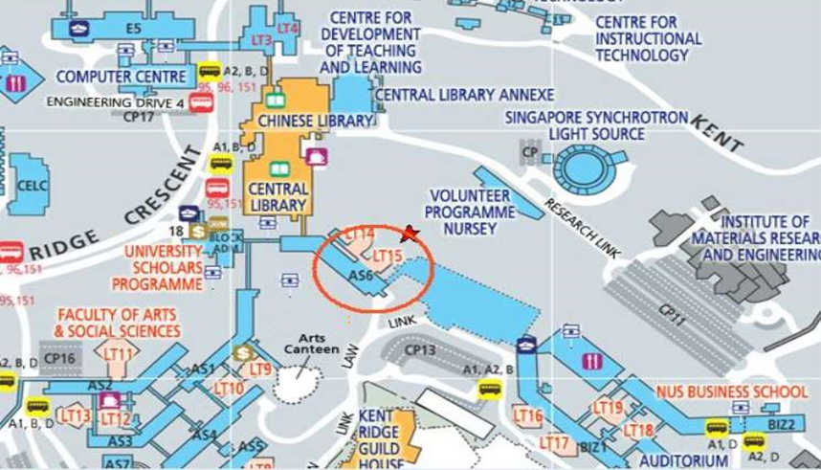
AS6 : LT15

Slide 52
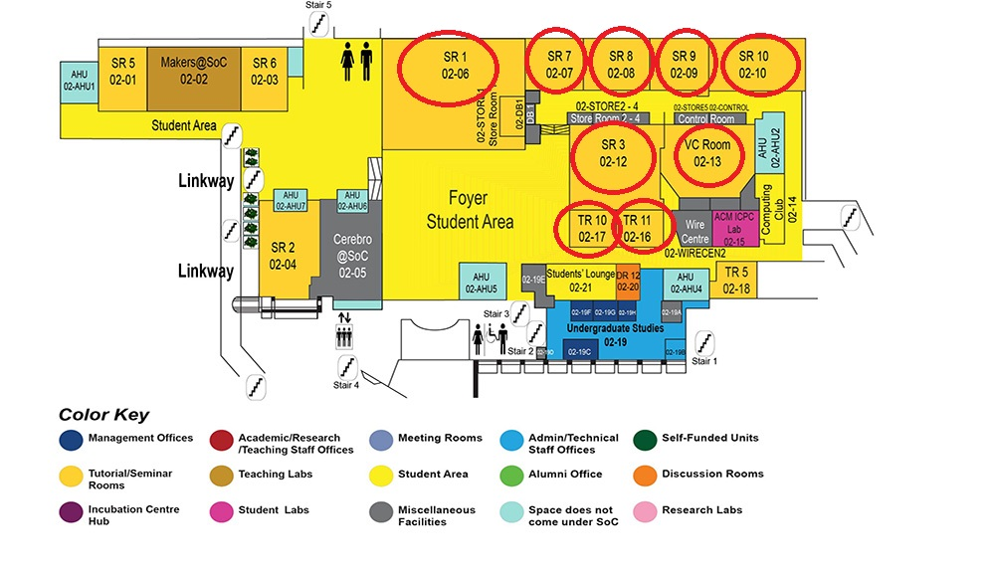
COM1: SR9

Slide 53
COM2: LT16 / TR9

Slide 54

to you in NUS / Singapore ……treasure every moment here (souvenir with discount available at NUS Co-op@LT27, SDE, Museum, UTown)
https://www.youtube.com/watch?v=6_DhlKUArac 《喜欢你》

Slide 55
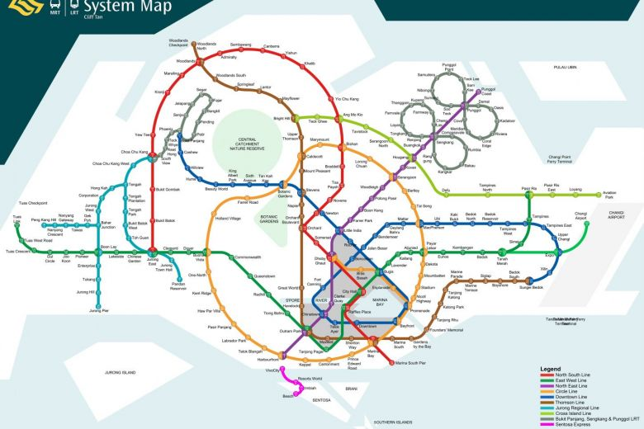
Singapore….
https://www.youtube.com/watch?v=xA0EST41Xl0 《我們這一班》
https://www.youtube.com/watch?v=_-mx27fNCLM 《想当年》
https://www.youtube.com/watch?v=k4ajzYt-xuE&list=PLTAbZaF8zPyX6jnxhFzML89UMroA1ZBxr&index=5 《一步一步來》
https://www.youtube.com/watch?v=URuTrLs7Vtk 《細水長流》

Slide 56
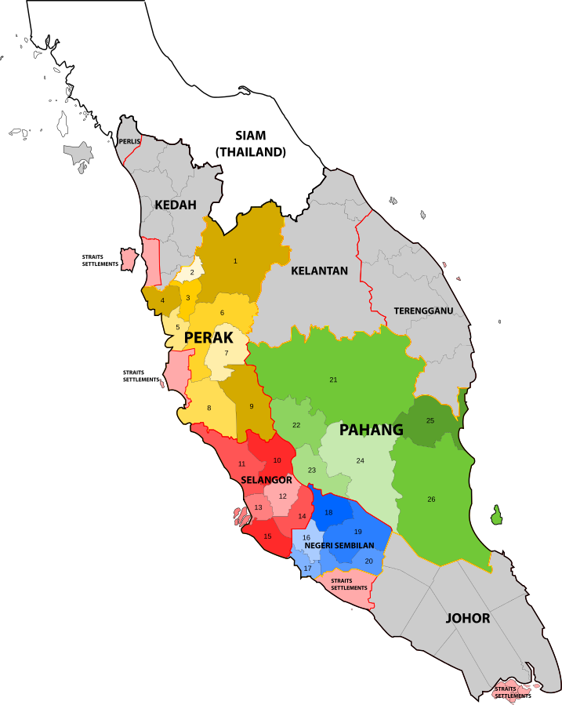
North of Singapore….Malaysia
https://www.youtube.com/watch?v=p4srZf2o_j0 (Malaysia) 《聽見癡情的他說愛你》
https://www.youtube.com/watch?v=PKqqN7cS-uc&list=RDp4srZf2o_j0&index=2 (Malaysia) 《小幸运》
https://www.youtube.com/watch?v=j5LMcjHCLwA&list=PLbkZtFBw7j4SPH4Moo6kbp_VwQykxsnut&index=4 (Malaysia) 《我只在乎你》
https://www.youtube.com/watch?v=YONFb6kffXI (Malaysia) 《我是一只小小鸟》
https://www.youtube.com/watch?v=79uuj5hXsOg (Malaysia) 《 馬來西亞查某 》
https://www.youtube.com/watch?v=n1Zimt8c0Ds (Malaysia) 《 馬來西亞本地水果篇 Little Apple 》

Slide 57
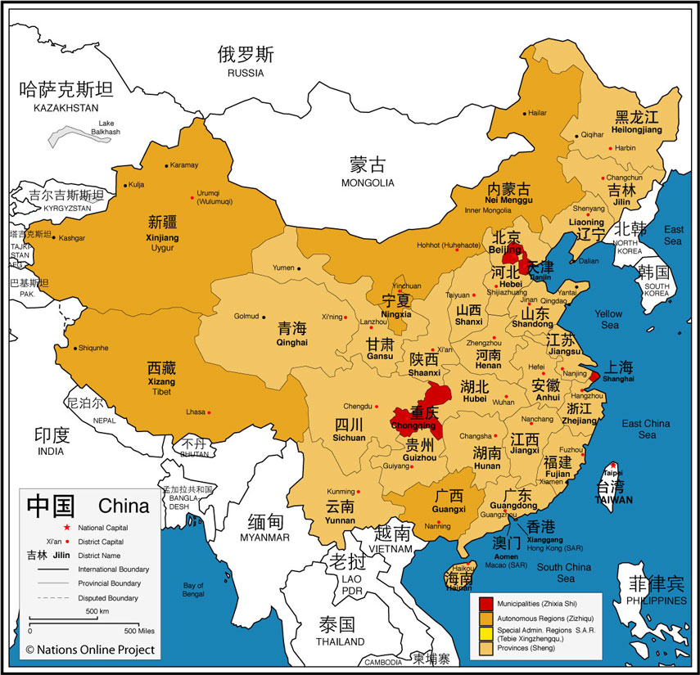
China / Korea / …
https://www.youtube.com/watch?v=B8igPU-MYQs&list=RD_-mx27fNCLM&index=12 (Chinese/Korean) 《好想你》
https://www.youtube.com/watch?v=ctjgp4w1bA4 (Chinese/Korean) 《我们不一样 》
https://www.youtube.com/watch?v=-gb3n1LcxKM&list=RDctjgp4w1bA4&index=3 (Chinese/Korean) 《不得不爱》

